Slide 1
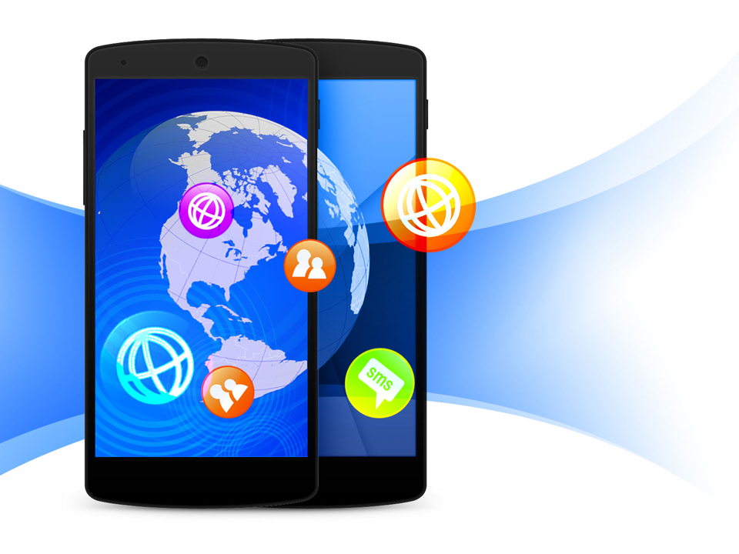
Mobile Application Development
Introduction

Slide 2


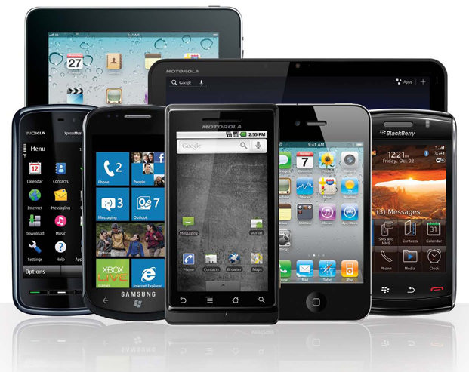
Mobile Application?
Mobile application (app) is a software application developed specifically for use on small or wireless computing devices, such as smartphones and tablets, rather than desktop or laptop computers.

Slide 3
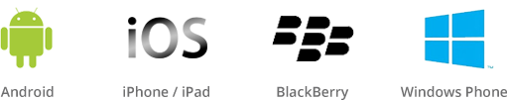
Mobile App Operating System?
Mobile app operating system (OS) such as:
Android (Google)
iOS (Apple)
BlackBerry OS (BlackBerry)
Windows Phone (Microsoft)

Slide 4
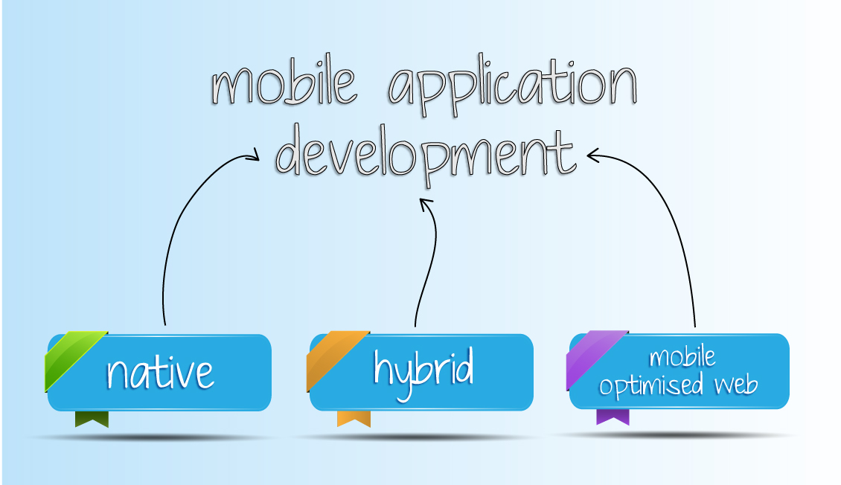
Mobile App Types?
Mobile app types can be generally broken down into:
Native Apps
Web Apps
Hybrid Apps

Slide 5



Native App?
Native apps - are built for a specific platform with the tools provided by the platform vendor. Example:
iOS using Xcode / Objective-C, Swift
Android using Android Studio / Java
Windows Phone using Visual Studio / C#

Slide 6
Native App?
Native apps take full advantage of the operating system by:
Directly interfacing with device hardware like the camera, accelerometer, compass, or GPS
Accessing data and information on the phone such as contacts, photos, videos, and music
Notes:
An Accelerometer is a motion sensor that detects the change (delta) in movement relative to the current device orientation, in three dimensions along the x, y, and z axis.

Slide 7
Web App?
Web apps - are application program that is stored on a server and delivered over the Internet through a browser interface.
Web apps are built with any server-side technology such as PHP, Java or ASP.NET that render HTML code to perform well on a device browser.

Slide 8

Hybrid App?
Hybrid apps – are web application built with web technologies (HTML, JavaScript, CSS) that is then "wrapped" in native device code to extend the functionality and availability of the app
It is the marriage of web technology and native execution.

Slide 9
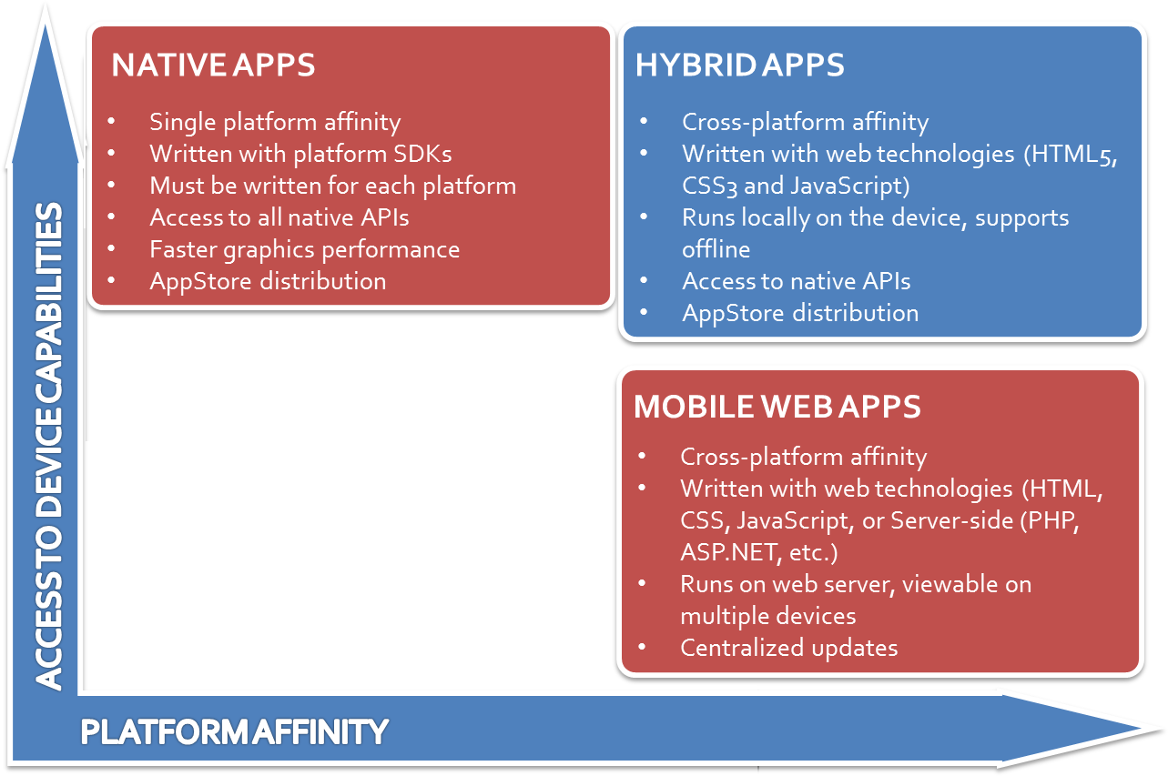

Slide 10
Getting Started

